Slide 1
Arithmetic Operations

Slide 2
Arithmetic Instructions
Add
Subtract
Increment
Decrement
Multiply
Divide
Decimal adjust

Slide 3
Arithmetic Instructions
Mnemonic | Description
ADD A, byte | add A to byte, put result in A
ADDC A, byte | add with carry
SUBB A, byte | subtract with borrow
INC A | increment A
INC byte | increment byte in memory
INC DPTR | increment data pointer
DEC A | decrement accumulator
DEC byte | decrement byte
MUL AB | multiply accumulator by b register
DIV AB | divide accumulator by b register
DA A | decimal adjust the accumulator

Slide 4

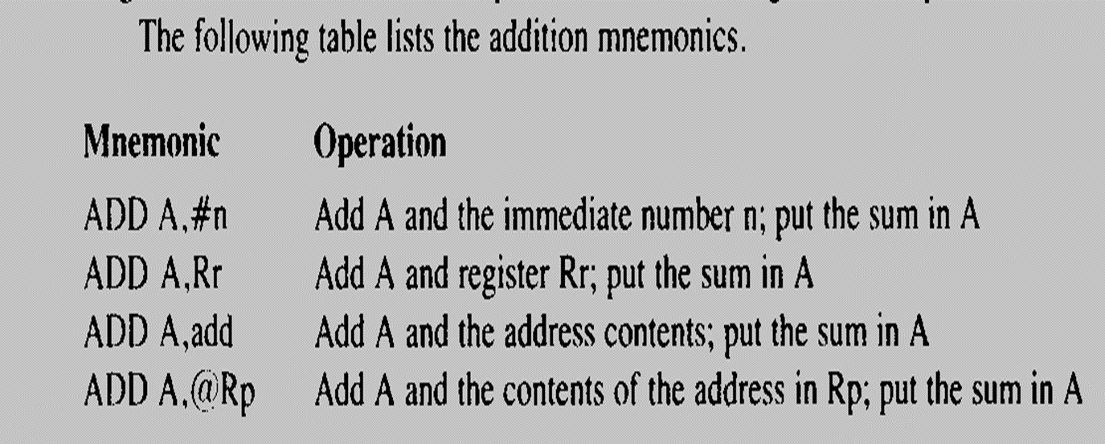

Slide 5
ADD Examples
mov a, #0x3F
add a, #0xD3
What is the value of the C, AC, OV flags after the second instruction is executed?
0011 1111
1101 0011
0001 0010
C = 1
AC = 1
OV = 0

Slide 6
Subtract
SUBB A, byte | subtract with borrow
Example:
SUBB A, #0x4F ; A ← A – 4F – C
Notice that there is no subtraction WITHOUT borrow. Therefore, if
a subtraction without borrow is desired, it is necessary to clear the C
flag.

Slide 7



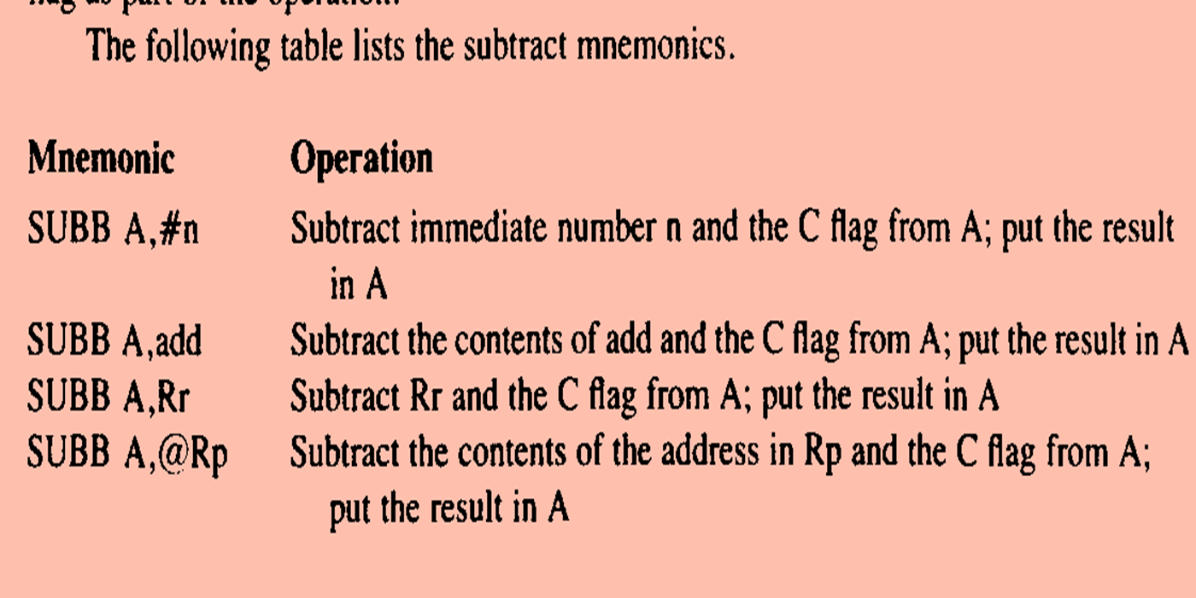

Slide 8
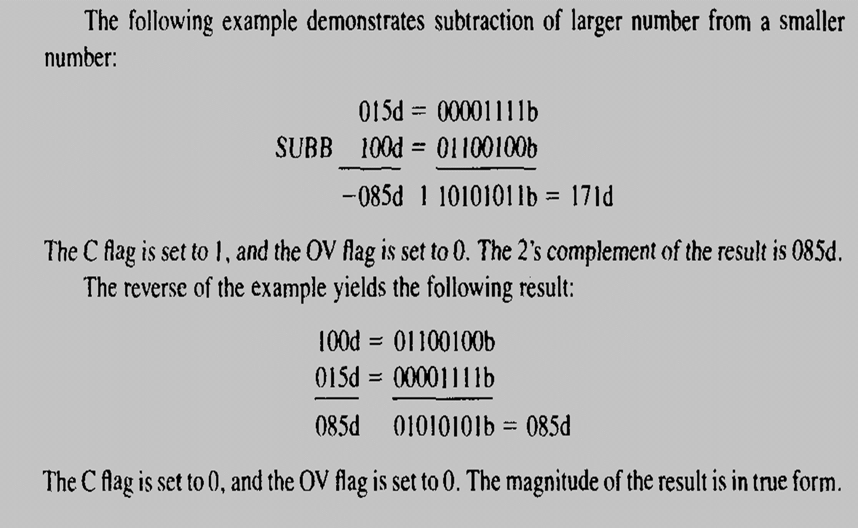

Slide 9
Increment and Decrement
INC A | increment A
INC byte | increment byte in memory
INC DPTR | increment data pointer
DEC A | decrement accumulator
DEC byte | decrement byte
The increment and decrement instructions do NOT affect the C flag.
Notice we can only INCREMENT the data pointer, not decrement.

Slide 10



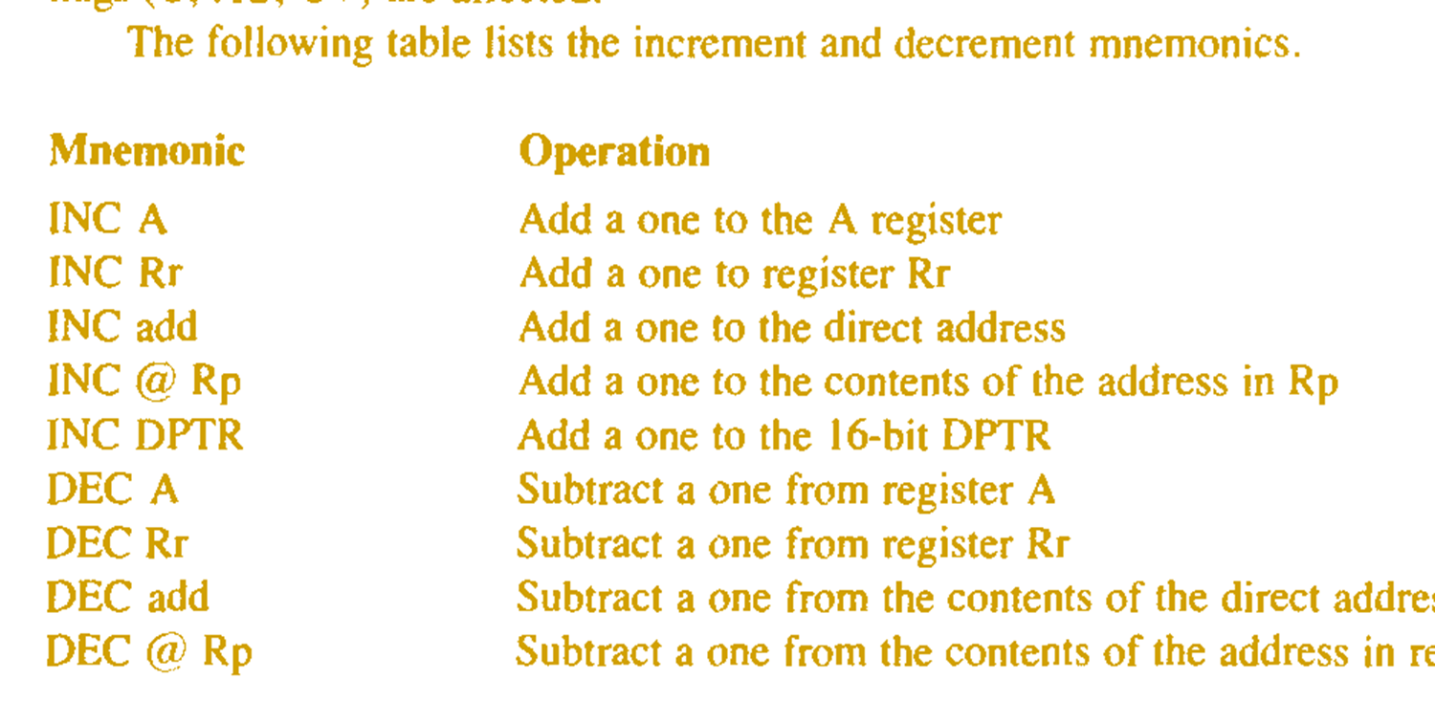

Slide 11
Multiply
When multiplying two 8-bit numbers, the size of the maximum product is 16-bits
FF x FF = FE01
(255 x 255 = 65025)
MUL AB ; BA ← A * B
Note: B gets the HIGH byte, A gets the LOW byte

Slide 12
Division
Integer Division
DIV AB ; divide A by B
A ← Quotient(A/B), B ← Remainder(A/B)
OV - used to indicate a divide by zero condition.
C – set to zero

Slide 13

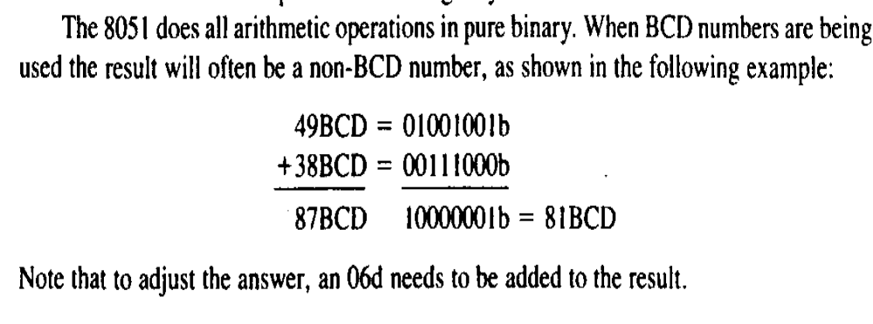

Slide 14
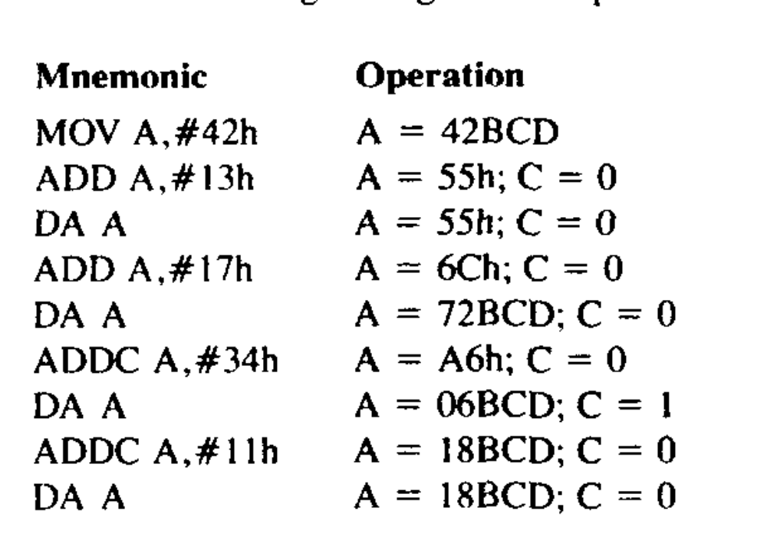

Slide 15
Logical Operations

Slide 16
Logic Instructions
Bitwise logic operations
  (AND, OR, XOR, NOT)
Clear
Rotate
Swap
Logic instructions do NOT affect the flags in PSW

Slide 17
Bitwise Logic
Examples:
00001111
10101100
ANL ➔ AND
ORL ➔ OR
XRL ➔ XOR
CPL ➔ Complement
ANL
00001100
00001111
10101100
ORL
10101111
00001111
10101100
XRL
10100011
CPL
10101100
01010011

Slide 18
Other Logic Instructions
CLR - clear
RL – rotate left
RLC – rotate left through Carry
RR – rotate right
RRC – rotate right through Carry
SWAP – swap accumulator nibbles

Slide 19
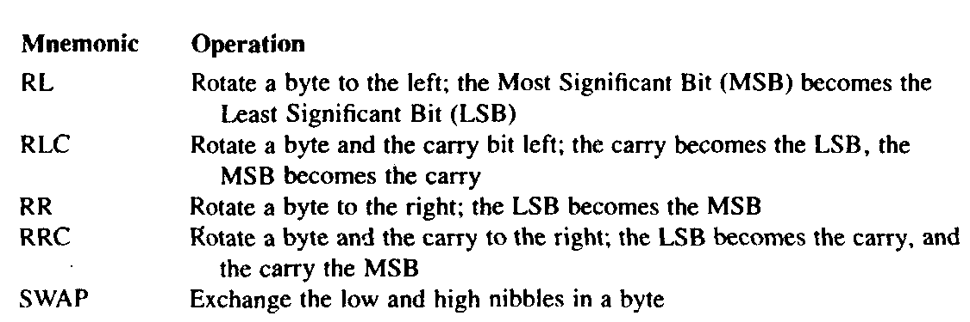

Slide 20
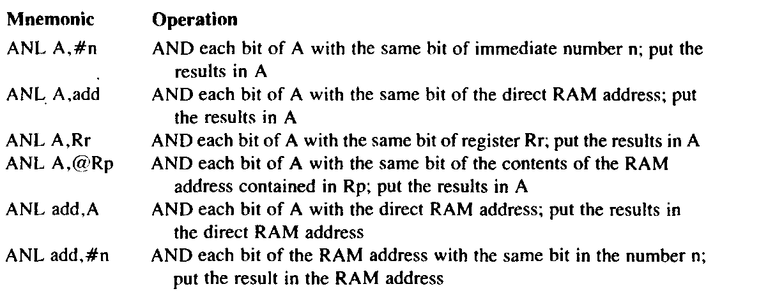
Byte Level Logical Operation

Slide 21
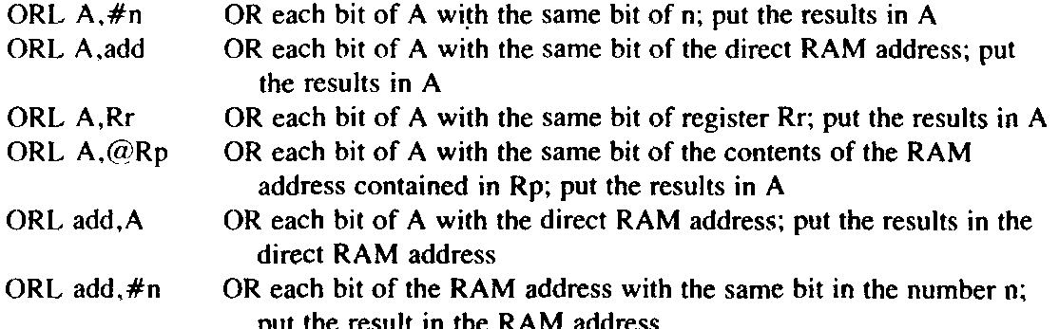
Byte Level Logical Operation

Slide 22
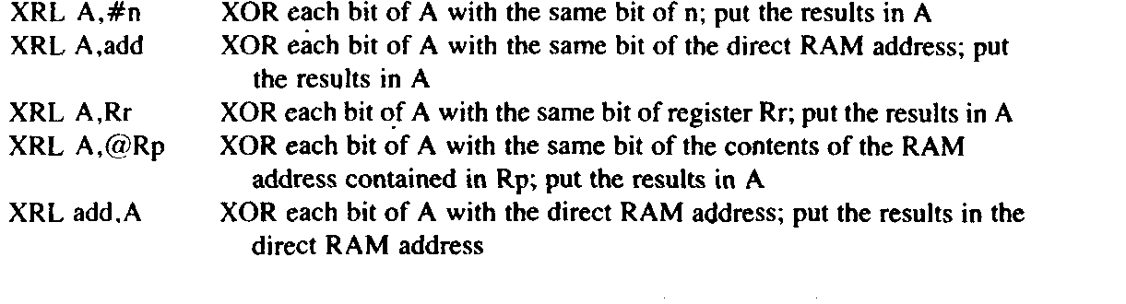
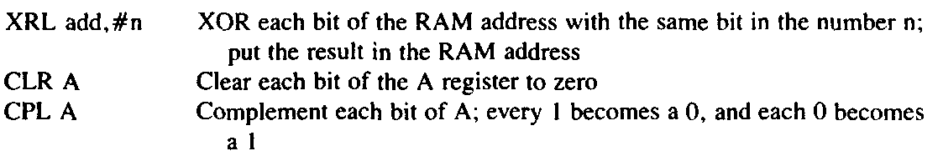
Byte Level Logical Operation

Slide 23
CLR ( Set all bits to 0)
CLR A
CLR byte (direct mode)
CLR Ri (register mode)
CLR @Ri (register indirect mode)

Slide 24
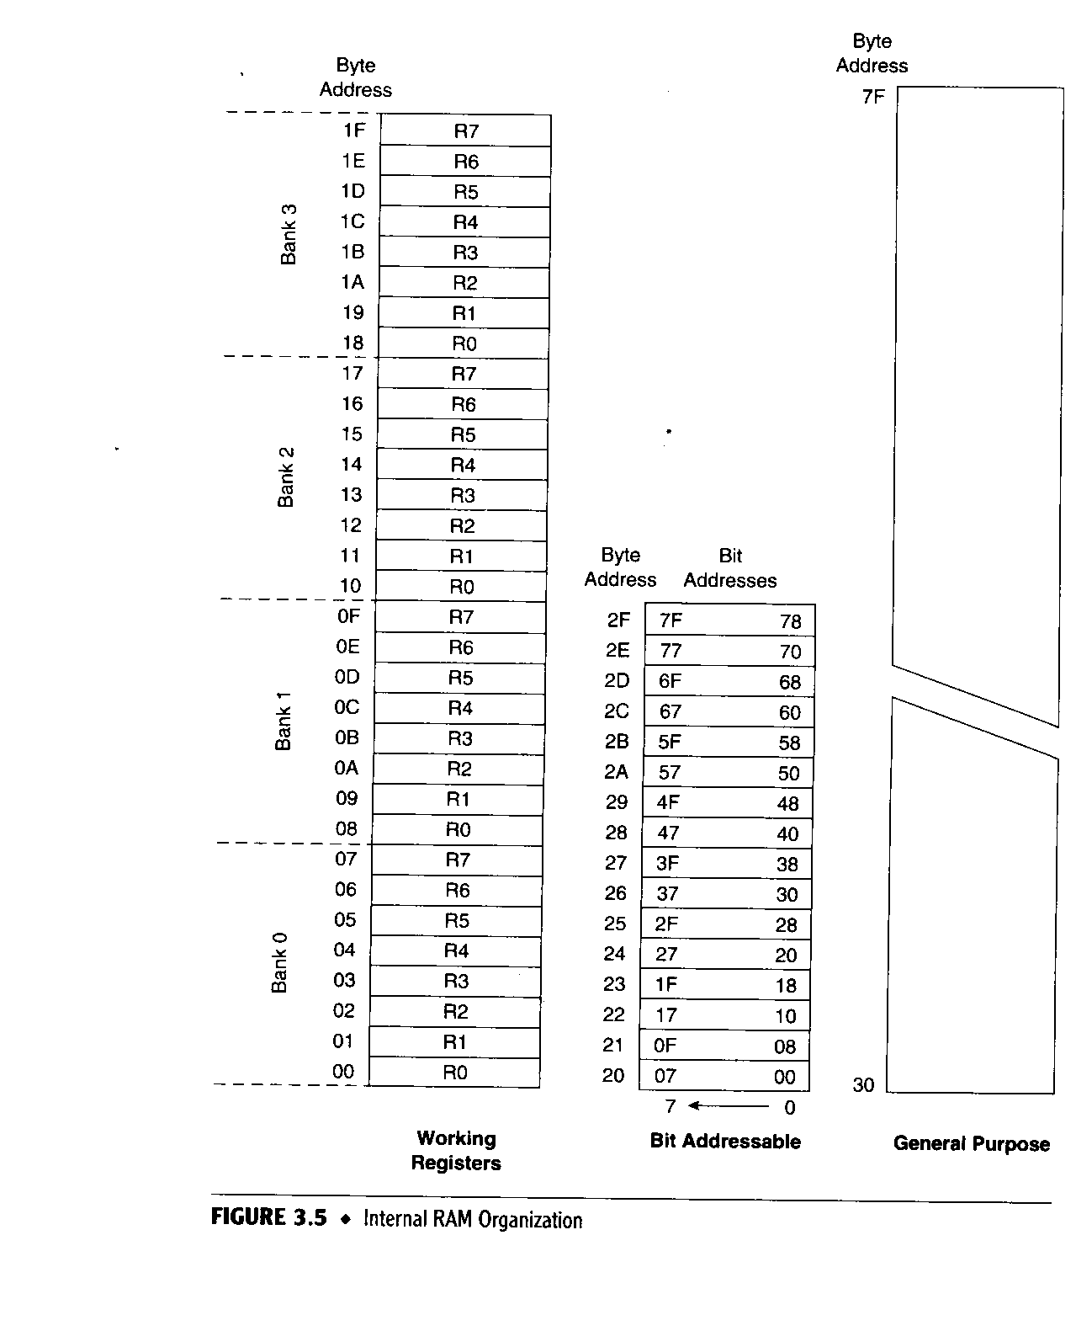
Bit-Level Logical Operations
Internal RAM Bit Addresses

Slide 25
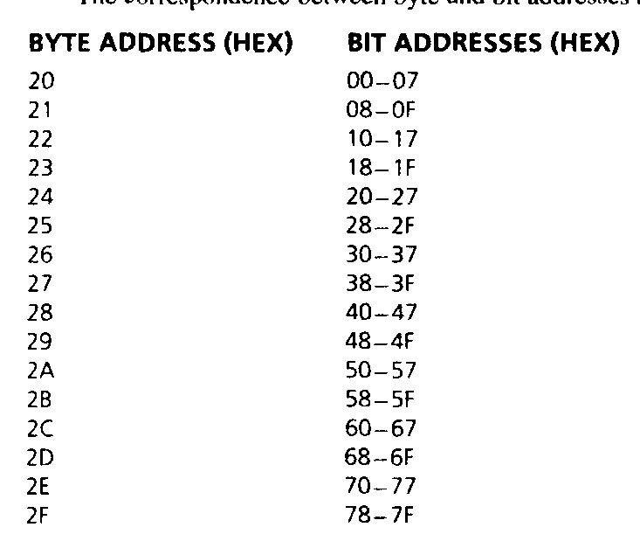
Bit-Level Logical Operations
Internal RAM Bit Addresses

Slide 26
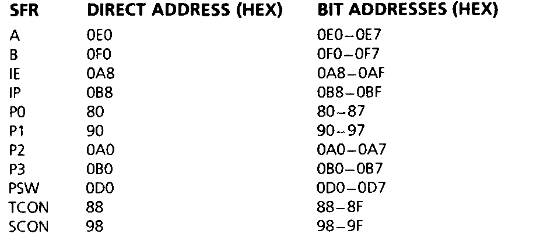
SFR Bit Addresses

Slide 27
Introduction
A jump permanently changes the contents of the program counter if certain program condition exists .
A call temporarily changes the program counter to allow another part of the program to run

Slide 28
Introduction
Jump on bit condition
Compare bytes and jump if not equal
Decrement byte and jump if zero
Jump unconditionally
Call a subroutine
Return from a subroutine

Slide 29
The jump and call range
Jump or call instruction may have one of the three ranges .
Relative range
  +127d , -128d
Absolute range
  2k byte
long range
  Address from 0000h to FFFFh

Slide 30
Program Flow Control
Unconditional jumps (“go to”)
Conditional jumps
Call and return

Slide 31
Unconditional Jumps
SJMP <rel addr> ; Short jump, relative address is 8-bit 2’s complement number, so jump can be up to 127 locations forward, or 128 locations back.
LJMP <address 16> ; Long jump
AJMP <address 11> ; Absolute jump to anywhere within 2K block of program memory
JMP @A + DPTR ; Long indexed jump

Slide 32
Conditional jumps
Mnemonic | Description
JZ <rel addr> | Jump if a = 0
JNZ <rel addr> | Jump if a != 0
JC <rel addr> | Jump if C = 1
JNC <rel addr> | Jump if C != 1
JB <bit>, <rel addr> | Jump if bit = 1
JNB <bit>,<rel addr> | Jump if bit != 1
JBC <bir>, <rel addr> | Jump if bit =1, clear bit
CJNE A, direct, <rel addr> | Compare A and memory, jump if not equal

Slide 33
More Conditional Jumps
Mnemonic | Description
CJNE A, #data <rel addr> | Compare A and data, jump if not equal
CJNE Rn, #data <rel addr> | Compare Rn and data, jump if not equal
CJNE @Rn, #data <rel addr> | Compare Rn and memory, jump if not equal
DJNZ Rn, <rel addr> | Decrement Rn and then jump if not zero
DJNZ direct, <rel addr> | Decrement memory and then jump if not zero

Slide 34
Subroutine - Example
$include (c8051f020.inc)
GREEN_LED equ P1.6
cseg at 0
ljmp Main
cseg at 0x100
Main: mov WDTCN, #0DEh
mov WDTCN, #0ADh orl P1MDOUT,#40h
mov XBR2, #40h
clr GREEN_LED
Again: acall Delay
cpl GREEN_LED
sjmp Again
Delay: mov R7, #02
Loop1: mov R6, #00h
Loop0: mov R5, #00h
djnz R5, $
djnz R6, Loop0
djnz R7, Loop1
ret
END
reset vector
main program
subroutine

Slide 35
Subroutine – another example
; Program to compute square root of value on Port 3 (bits 3-0) and
; output on Port 1.
$INCLUDE (C8051F020.inc)
cseg at 0
ljmp Main
Main: mov P3MDOUT, #0 ; Set open-drain mode
mov P3, #0xFF ; Port 3 is an input
mov P1MDOUT, #0xFF ; Port 1 is an output
mov XBR2, #40h ; Enable crossbar
loop: mov a, P3
anl a, #0x0F ; Clear bits 7..4 of A
lcall sqrt
mov P1, a
sjmp loop
sqrt: inc a
movc a, @a + PC
ret
squares: db 0,1,1,1,2,2,2,2,2,3,3,3,3,3,3,3
end
reset vector
main program
subroutine
data

Slide 36
Interrupts
An interrupt is hardware –generated call
The subroutines called by an interrupt are fixed hardwired address
        Interrupt hex (add)
        IE0 0003
        TF0 000B
        IE1 0013
        TF1 00B1
        SERIAL 0023

